Slide 1
Sustainability Capstone:
Decarbonising Travel
A Data driven Framework For Sustainable Corporate Travel Decisions.
Speaker name: Fathima Rafeeda M V
Institute: IIT Roorkee
Branch & Year of Study: Geological Technology , 2nd year.
Email ID: finumv@gmail.com
Institute Email ID: fathima_rmv@es.iitr.ac.in

Slide 2
Executive Summary
Key Metrics
Top 3 Insights
Top 3 Recommendations
  65,289 Total Trips Analyzed
  178,090 t Total CO₂ Emissions
  €140.5M Total Travel Cost
  Customer Visits and Conference/Exhibitions account for 78.68% of total travel emissions, making them the largest emission hotspots.
  ​2,508 European short-haul trips eligible to shift from premium to economy or rail
  EV adoption remains significantly underutilized for eligible road journeys.
  Promote early approvals and bookings to reduce costs and unlock lower-carbon options.
  Prioritize economy class for short-haul flights; encourage rail for eligible journeys.
  Expand virtual collaboration for internal meetings; increase EV adoption for road. travel
Projected Impact
  Reduced travel-related CO₂ emissions through greater adoption of rail, economy class, electric vehicles, and virtual collaboration.
  Lower corporate travel expenditure by encouraging advance bookings and reducing unnecessary premium-class travel.
  Improved ESG performance by embedding carbon-aware decision-making into the travel approval process.
  Accelerated progress toward 2030 emissions reduction targets through scalable, data-driven sustainability initiatives.
Decarbonizing business travel is critical to achieving Celonis' 2030 emissions reduction targets. With 178,090 tCO₂e generated across 65,289 trips, systematic shifts toward lower-emission modes represent the single largest lever for scalable, measurable progress against corporate sustainability commitments.

Slide 3

Emissions Profile and Benchmarking.
Comparing regional and travel-mode emissions against current industry sustainability practices.
Industry Benchmark
Benchmark |  | Celonis Dataset
Air travel is the largest source of business travel emissions. |  | Flights are the largest emission source (73.1k tCO₂e).
Organizations promote rail and virtual collaboration for short-distance journeys. |  | 2,508 European short-haul trips can shift to rail/economy.
Sustainability policies focus on high-emission business activities. |  | Customer Visits, Enablement & Conferences account for 60.41% of emissions.
Fleet electrification is an emerging priority. |  | Electric vehicles remain significantly underutilized.
  Oceania accounts for 50% of total emissions despite representing only 33% of trips, indicating disproportionately carbon-intensive long-haul routes.
  Business-class flights dominate travel mode emissions at 73.1k tCO2e — over 50x the emissions of train travel (1.4k tCO2e), confirming air travel as the primary decarbonization lever.
  Within the analyzed trips, electric vehicles generated 1.2k tCO₂e compared with 11.1k tCO₂e for diesel vehicles, indicating substantial potential for greater EV adoption where feasible.
Sources: Deloitte 2025 Corporate Travel Study; GBTA Sustainability Benchmark 2025; Celonis internal travel data

Slide 4
Hotspot Analysis
Emissions by Travel Purpose
Emissions by Business Unit
Top Emission-Intensive Routes
Others
2.84%
Value Eng.
9.79%
Route | tCO₂e
São Paulo → Johannesburg | 11,363,745
Sydney → Singapore | 10,269,409
São Paulo → Miami | 8,647,218
Sydney → Los Angeles | 8,245,017
Beijing → New Delhi | 7,264,487
Enablement
7.18%
Sales
33.56%
Customer Visits
43.22%
Cust. Support
8.30%
Internal Mtgs
11.30%
78.68%
Top 2 categories
52.42%
Marketing + Sales
Marketing
18.86%
Conference
35.46%
Others
29.49%
Key Insight
Key Findings
78.68%
of total travel emissions come from just two purposes: Customer Visits (43.22%) and Conference/Exhibition (35.46%).
  Long-haul premium-class travel is the largest contributor to route-level emissions.
  Sales and Marketing account for over half of business-unit travel emissions (52.42%).
  Just five routes generate over 45.8M tCO₂e, highlighting concentrated decarbonization opportunities.
Targeted Intervention Priority: Prioritize Customer Visits and Conference travel within Sales and Marketing, while optimizing high-emission intercontinental routes to maximize emission reductions.

Slide 5
Inefficiencies Identified
Policy Non-Compliance
Expense Processing Issues
Fossil-Fuel Vehicle Dependence
17% of expense claims rejected
  Personal expenses & duplicate claims.
  Out-of-policy bookings & Exceeded spending limits.
16,569 trips on diesel/petrol
  Generated 24.2M tCO₂e
  Cost €35.9M
18% of trips booked outside policy.
  Reduced access to advance-booking discounts.
  Limited availability of lower-carbon travel options.
Transport Mode Changes
European Short-Haul Flights
Reimbursement Delays
6,724 trips required mode changes
  Generated 11.0M tCO₂e
Driven by vehicle issues, rental availability, and airline schedule changes.
2,508 short-haul trips via air.
  Viable rail alternatives: Berlin → Amsterdam, Berlin → Paris
  85% of trips take ~16 days to submit expense claims after receiving confirmation.
• Delays reimbursement and financial visibility
Critical Intervention Required: Addressing policy violations, fossil-fuel vehicle usage, unnecessary transport changes, and short-haul flights presents the largest opportunity to reduce both emissions and travel costs.

Slide 6
Low Carbon Strategic Recommendations (Quantified)
Recommendation | Data-backed opportunity | Expected impact
Advance Booking & Policy Compliance | 18% of trips booked outside policy, reducing access to advance fares. | 43.5M tCO₂e . €25.9M . Policy optimization
Rail First | Replace Berlin–Paris and Berlin–Amsterdam flights with rail where feasible (507 eligible trips). | 211.6k tCO₂e · €1.06M . Rail substitution
EV Fleet | Replace diesel and petrol rental vehicles with EVs in EV-ready cities (e.g., Hamburg, Fukuoka). | 24.2M tCO₂e · €35.9M . Fleet electrification
Virtual Meetings | Convert internal meetings, enablement travel and suitable conferences to virtual-first. | 96.1M tCO₂e.€75.8M . Virtual collaboration
Carbon Approval Workflow | Require secondary approval for trips exceeding route-specific CO₂ thresholds while recommending lower-carbon alternatives using AI tools. | Improved policy compliance and lower-carbon booking decisions.
Department Carbon Targets | Reduce Sales & Marketing travel by 8% through trip consolidation and virtual collaboration. | 7.7M tCO₂e .€6.28M . Department optimization
Expected Outcomes: Up to 171M+ tCO₂e eligible for reduction, €109M+ in potential travel cost optimization, improved policy compliance, and accelerated progress toward Celonis' 2030 sustainability targets.

Slide 7

Strategic Integration Roadmap
2029–2030
2026
Intelligent Sustainable Travel
Foundation & Policy
  Dynamic carbon approval rules
  AI-powered low-carbon itinerary recommendations
  Real-time carbon optimization
  ESG reporting automation
  Carbon-aware travel policy
  Advance booking enforcement
  Real-time travel emissions monitoring
  Department emission tracking
2027–2028
Operational Transformation
  Rail-first for European routes
  EV rentals in EV-ready cities
  Virtual-first internal meetings
  Department carbon budgets
2030 VISION: Every travel request is evaluated not only by cost and convenience, but also by its carbon impact — enabling intelligent, automated, and sustainable travel decisions across Celonis.

Slide 8
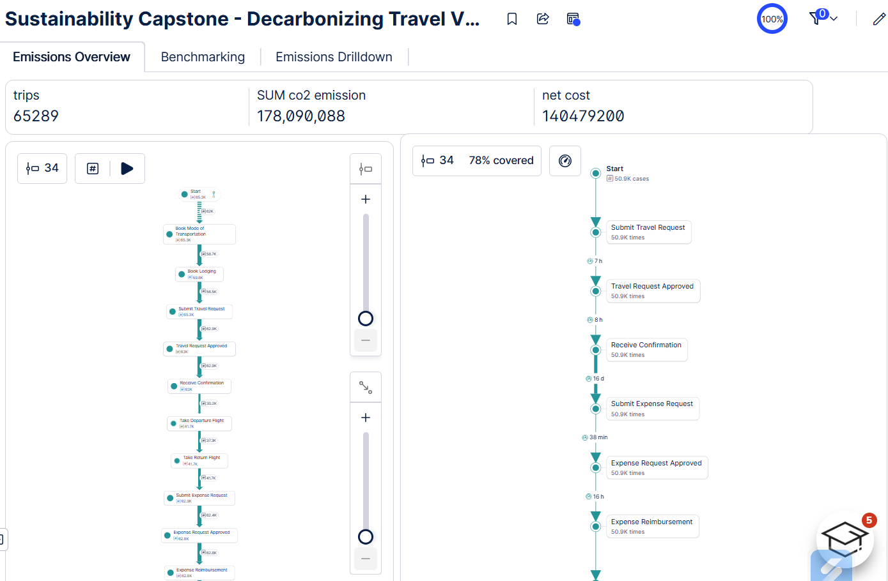
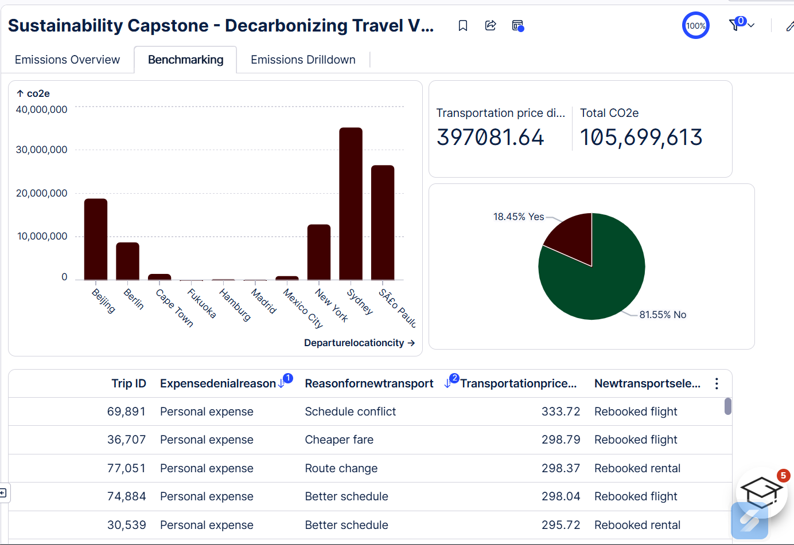
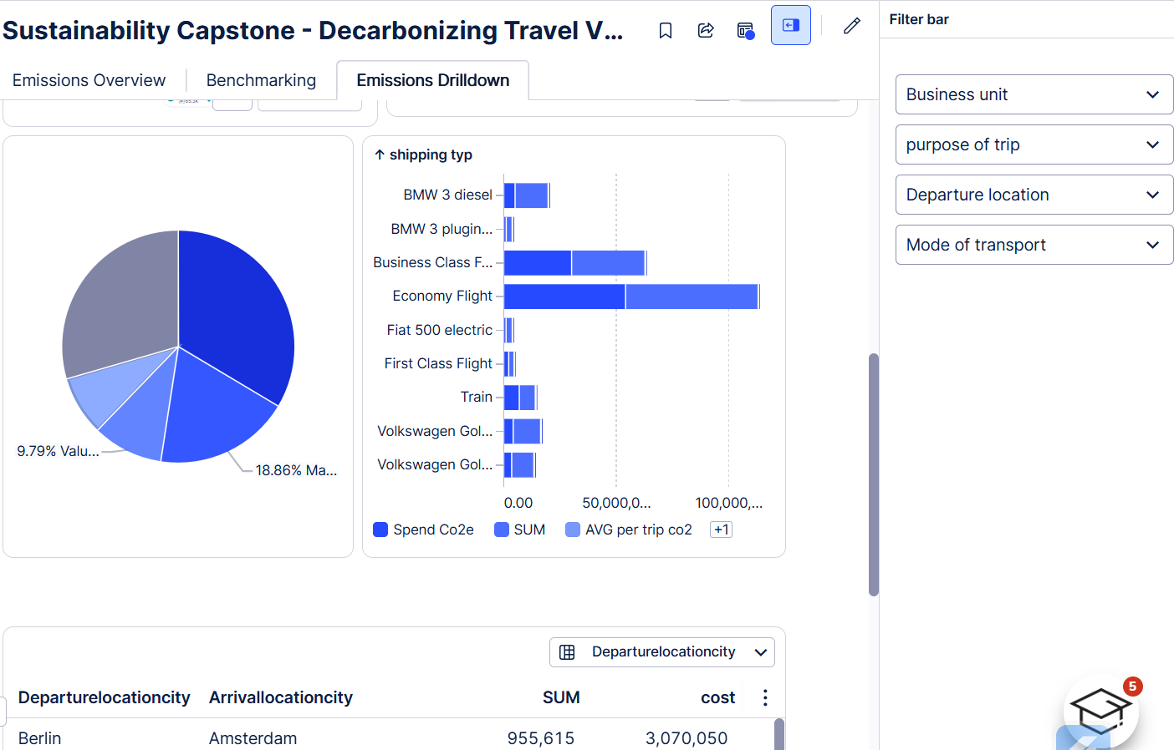
Dashboard Screenshots
65k+ trips analysed,
178M tCO₂e and €140.5M travel spend monitored.
Identified the dominant travel execution path and analysed emissions at every process stage.
Expense claims take ~16 days after confirmation, highlighting a major reimbursement bottleneck.
Compared emissions across departure cities to identify regional emission hotspots.
14.55% of trips are out of policy.
Measured cost impact and emission impact of transport changes.
Analysed expense rejection reasons and re-bookings.
Filtered emissions by business unit, travel purpose, departure location, and transport mode for targeted analysis.
Business unit breakdown highlights highest-emitting departments.
Transport mode comparison reveals EV, rail and flight emission opportunities.
Route-level table identifies city-specific emission hotspots.

Slide 9
Results at a glance
65,289
178M tCO₂e
€140.5M
171M+ tCO₂e
€109M+
6
Trips Analyzed
Travel Emissions
Analyzed
Travel Spend
Analyzed
Potential Emissions
Eligible for Reduction
Potential Travel
Cost Optimization
Data-Driven
Recommendations
Key Achievements
✓ | Identified 78.68% of emissions from Customer Visits and Conferences.
✓ | Discovered 18% out-of-policy bookings reducing advance-booking opportunities.
✓ | Found 2,508 European short-haul flights suitable for rail substitution.
✓ | Identified 16,569 fossil-fuel vehicle rentals suitable for EV replacement.
✓ | Highlighted ~16-day reimbursement delay after travel confirmation.
✓ | Developed a distance-based carbon approval workflow for high-impact travel.
Environmental
Financial
Operational
Strategic
  Lower travel emissions through rail, EVs and virtual collaboration.
  Supports Celonis' 2030 sustainability targets.
  Significant travel cost optimization from policy compliance, modal shift and EV adoption.
  Faster approvals, improved policy compliance and better travel planning.
  Carbon-aware travel governance with department accountability and automated decision support.

